Slide 1
Shell Bootcamp 2024 3 Reflections for Week #<>
Zainab Mujtaba
Date : 30-Aug-2024

Slide 2

About Me
"Focus on delivering results while valuing the human element in every interaction."

Slide 3

My learnings from this week!

Slide 4
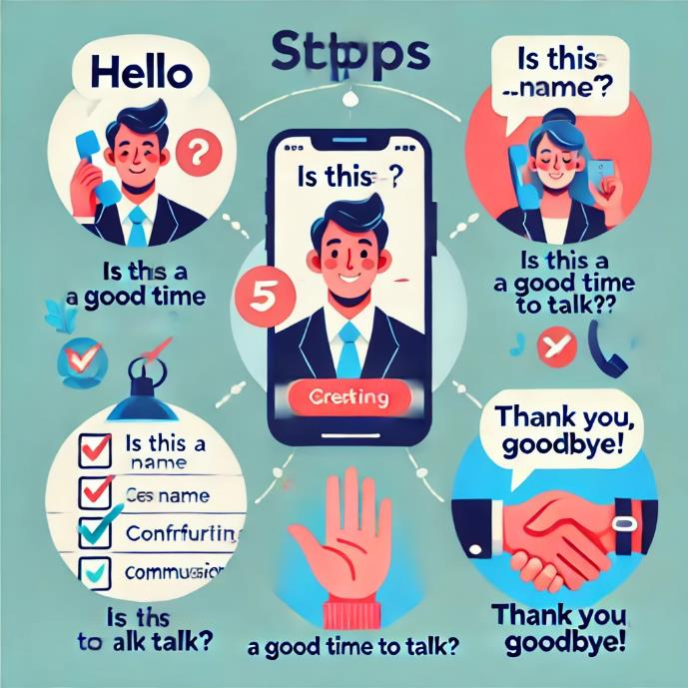
Learning 1 | My takeaways
Telephone Etiquette: A Key Learning Proper telephone etiquette is essential for respectful and effective communication. By following structured guidelines, we can ensure that our interactions are professional and clear.
Key Takeaway:- Adhering to good telephone etiquette fosters professionalism and enhances communication.
Application in the Energy Sector:- In the energy sector, clear communication through proper etiquette is paramount for safety and collaboration.

Slide 5

Learning 2 | My takeaways
Trust Enhancing: Trust is the foundation of successful relationships, whether between colleagues, clients, or stakeholders. Trust-enhancing practices involve fostering transparency, reliability, integrity, and effective communication.
Key takeaway: Building and maintaining trust is not a one-time effort but a continuous process that requires consistent behavior, clear communication, and the demonstration of competency.
Application in the energy sector: As the energy sector is closely scrutinized for its environmental impact, upholding high standards of environmental responsibility is essential.

Slide 6

Learning 3 | My takeaways
Sandwich Framework for Feedback: This method involves “sandwiching” the constructive feedback between positive comments, making it easier for the recipient to accept and act upon the suggestions.
Key takeaway: By starting and ending with positive feedback, it reassures the individual of their strengths while constructively addressing areas for improvement.
Application in the energy sector: When resolving conflicts or addressing underperformance within teams, the Sandwich Framework can help managers deliver difficult messages without demoralizing the team.
[Add a graphic that provides evidence of what you learned]

Slide 7

Relevance of learnings for my organization

Slide 8
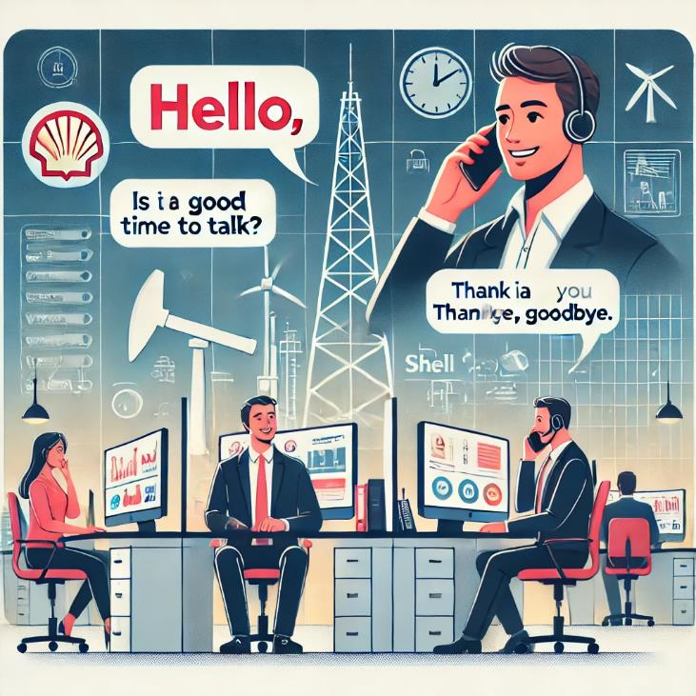
Learning 1 | Relevance for Shell
"Shell effectively teaches telephone etiquette to all new hires. This commitment to proper etiquette is evident in all internal and external interactions. Online meetings, in particular, are conducted with strict adherence to etiquette guidelines.
For Shell, this focus on communication is crucial. As an oil and gas company, maintaining clear and effective communication is essential for ensuring the safety of both employees and customers."

Slide 9

Learning 2 | Relevance for Shell
How I feel Shell implements this learning: In the energy sector, where projects often involve significant investment and long timelines, being transparent with all stakeholders—including customers, regulators, and partners—builds credibility.
How I feel Shell benefits from this learning: How an energy company handles crises—such as outages, accidents, or environmental incidents—can significantly impact trust. A prompt, transparent, and responsible response to such events can help maintain or even rebuild trust.
[Add a graphic that provides view of how Shell implements this learning]

Slide 10

Learning 3 | Relevance for Shell
How I feel Shell implements this learning: For example, after demonstrating a new renewable energy technology, an instructor could commend participants on their engagement, suggest areas where understanding needs to be deepened, and end with encouragement about their potential to master the technology.
How I feel Shell benefits from this learning: When implementing new processes or technologies in the energy sector, the Sandwich Framework can be used to communicate the benefits and challenges of change.
[Add a graphic that provides view of how Shell implements this learning]

Slide 11

Challenges in implementing learning

Slide 12
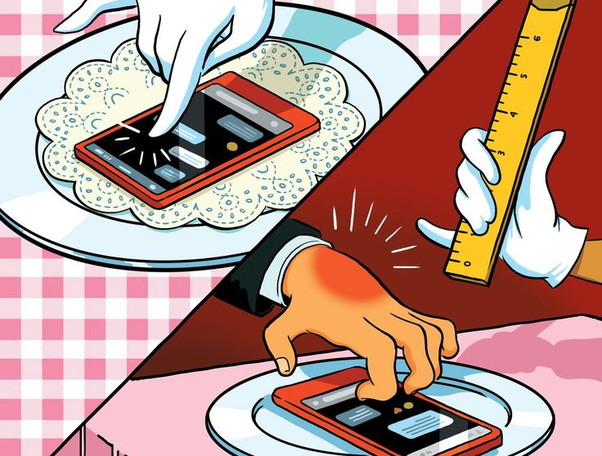
Challenge faced while implementing Learning 1
As a recent college graduate, I am still adjusting to the formal communication style expected in a professional office environment. It has been challenging for me to adapt my speech patterns.
While the underlying message may remain the same, the manner in which it is conveyed can significantly impact its effectiveness.
[Add a graphic that provides evidence of what you did to overcome this challenge]

Slide 13

Challenge faced while implementing Learning 2
[Add a graphic that provides evidence of what you did to overcome this challenge]
Challenge: Trust is built over time through consistent actions. However, inconsistency in leadership or management behaviours.
Impact: Inconsistent actions can lead to skepticism among employees, partners, and stakeholders, undermining the trust that has been established.

Slide 14
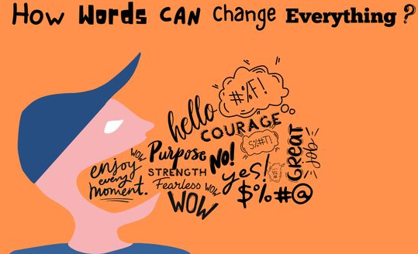
Challenge faced while implementing Learning 3
Challenge: If used too frequently or mechanically, the positive feedback in the Sandwich Framework can come across as insincere or superficial. Recipients might feel that the praise is just a prelude to criticism, reducing the impact of the positive feedback.
Impact: This can lead to distrust or disengagement, as employees might start to feel that the positive comments are not genuine.

Slide 15

Action Plan

Slide 16
My Action Plan for this Week
Actions
Timeline
Status
Pay close attention to the lessons presented in the training sessions.
Actively engage with colleagues to learn from their experiences and improve my own skills.
Conduct regular self-assessments to identify areas for development.
Learning from the lessons presented continues throughout the three-week training program.
Additionally, the other two areas for development—active engagement with colleagues and self-assessment—are ongoing processes that are essential for professional growth.
I have diligently followed the training lessons and gained valuable knowledge.
My peers are highly skilled and knowledgeable, and I have benefited greatly from interacting with them.

Slide 17

Learning is also Fun!

Slide 18

Learning is also Fun!
We did role play on what are the proper meeting etiquettes that we need to follow.
We also did a group where we made a presentation on a chart paper describing what integrity is.
We also made paper airplanes and learnt that we need to ask questions and get to know the scope of the work we are being assigned and not to blindly assume.

Slide 19

Summary
This week consisted of learning soft skills like call, mail and message etiquetts, how to work in a team, stake holder management, understating of the business analyst role and the agile scrum flow also a lot of fun interactions with my peers.
In the upcoming week we are going to be focusing on technical skills like dbms, scrum and other information which is going to be very important for our work.
Soft skills are going to be an integral part of all our interactions in the workplace. The stakeholder management and the scrum workflows are going to be help full when we are going to be developing a project as part of a team next week.

Slide 20
Thank You

